Slide 1


INTRODUCTION TO THE COMPLIANCE TEAM

Slide 2
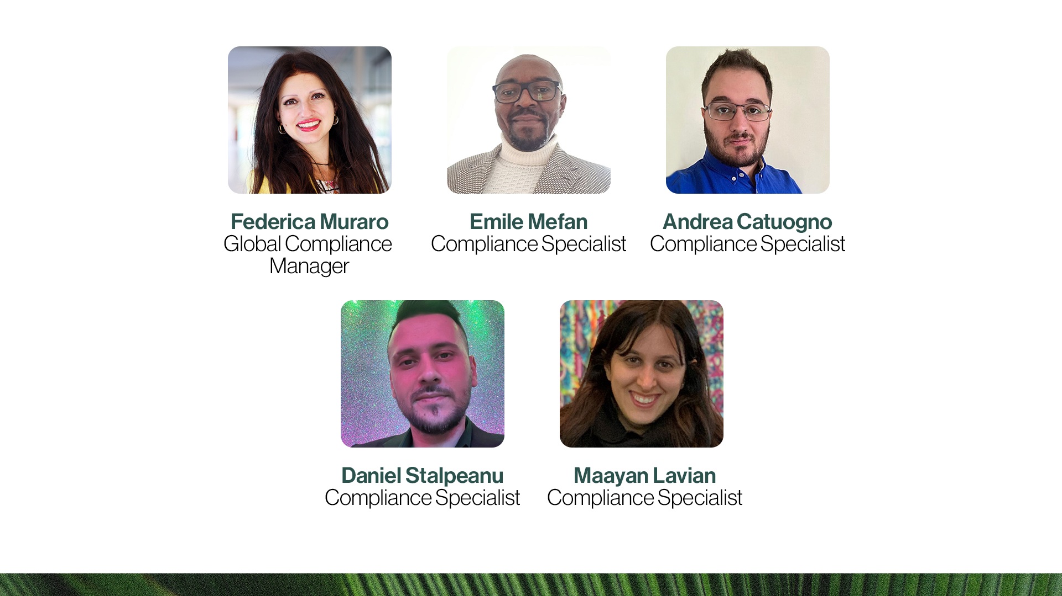

Slide 3

CLAIMS
CLAIM: any message or representation about a product that can be presented as:
Text
Picture
Graphic
Symbol
TYPES OF CLAIMS:
Nutritional
Medical
Health
Cosmetic
Income

Slide 4

INCOME CLAIMS: RULES
Present your business in a proper way
Be truthful, do not deceive or mislead
Do not offer or imply any guarantees of success
Keep in mind that Partner.Co pays commissions based on the sale
of products to end consumers
Make it clear that success comes
from hard work, effort, and dedication
Refer to the Policy Manual, section 2.4.15 on Income Claims
Check the Compensation Plan
on the Back Office Library

Slide 5
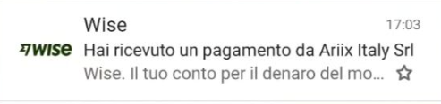
INCOME CLAIMS: RULES
Amount must be 100% covered
Date of the payment must be clearly visible
Hashtag #PARTNERCOBRANDPARTNER must be included (#INCARICATOALLEVENDITEPARTNERCO for Italy)
Specific disclaimer must be included

Slide 6

INCOME CLAIMS: HASHTAG
Hashtag #PARTNERCOBRANDPARTNER*
The hashtag helps you present yourself as a Brand Partner
and not as a customer
The hashtag clarifies your commercial intention and your aim to sell to final customers
The hashtag protects you and your business
Including the correct hashtag when sponsoring Partner.Co is mandatory
*#INCARICATOALLEVENDITEPARTNERCO for Italy

Slide 7
INCOME CLAIMS: INCOME DISCLAIMER
Results are personal and based on individual experience in Partner.Co, they are not guaranteed. Contact me for more information on our Compensation Plan.
Personal results may vary from person to person and are not guaranteed. The successes
or outcomes described or shown are the result of individual effort, skills, experience,
and commitment and do not necessarily represent the average or common result.
Partner.Co does not guarantee any level of income or success to any Brand Partner.
Earnings from the Partner.Co Compensation Plan depend on each Brand Partner’s sales,
business skills, ability and personal application.

Slide 8
APPROVED INCOME CLAIMS: EXAMPLES
DESCRIPTION + DISCLAIMER + HASHTAG
“I’m so excited to be making extra income to better support my family!”
“Let me show you how you can generate a supplemental income using the Partner.Co Compensation Plan.”
The results stated are personal, based on one's effort, skills, and experience, and are not general or guaranteed. Contact me for more information on our Compensation Plan. #PARTNERCOBRANDPARTNER
“I reached the title of Senior Officer in Partner.Co with lots of satisfaction, ask me how!”
The results are personal and based on individual experience in Partner.Co, they are not guaranteed. Contact me for more information on our Compensation Plan. #PARTNERCOBRANDPARTNER

Slide 9
APPROVED INCOME CLAIMS: EXAMPLES
DESCRIPTION + DISCLAIMER + HASHTAG
“Since I enrolled as a Brand Partner at Partner.Co with only €29.95, I have the possibility of having an extra income by helping many women and having the possibility to try Partner.Co products at an advantageous price. Contact me if you're interested.”
The results are subjective, not guaranteed and depend on various factors including commitment and dedication to the activity. #PARTNERCOBRANDPARTNER
“Would you like to learn how to earn additional income working from home and online?”
The results are subjective, not guaranteed and depend on various factors including commitment and dedication to the activity. #PARTNERCOBRANDPARTNER

Slide 10
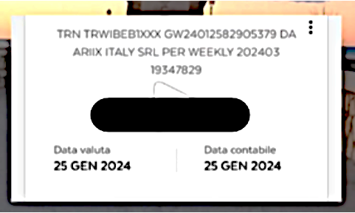
APPROVED INCOME CLAIMS
Disclaimer: The results are subjective, not guaranteed and depend on various factors including commitment and dedication to the activity. #PARTNERCOBRANDPARTNER

Slide 11
NOT APPROVED INCOME CLAIMS
Guaranteeing results, misleading the potential Brand Partner
Distorting the reality of past or current income
Claims without disclaimers nor hashtag
Showing commissions amounts
Talk about PASSIVE INCOME.
"My Partner.Co income exceeded my current salary after just a few months in the business"
"Our Partner.Co business has allowed my wife to stop working full-time"
"Would you like to earn an extra £/€1,000 this month?"
"Would you like to live on holiday?"
"Would you like to change your life and become rich?"

Slide 12
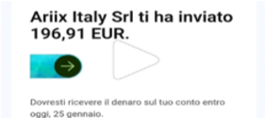
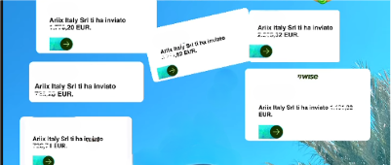
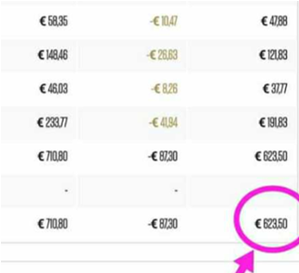
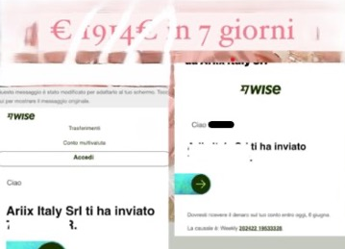
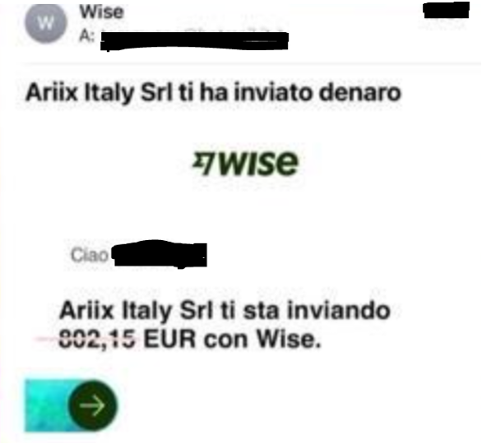
NOT APPROVED INCOME CLAIMS

Slide 13

Chase the vision,
not the money;
the money will end
up following you.
– Tony Hseih
“

Slide 14


