Slide 1
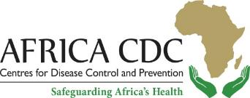
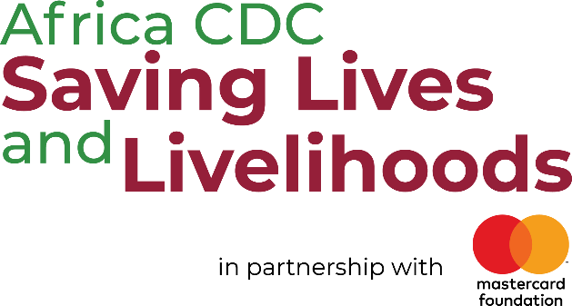
March 2023
In June 2021, the Mastercard Foundation partnered with the Africa CDC to launch the $1.5 billion Saving Lives and Livelihoods (SLL) initiative. Together, we are purchasing COVID-19 vaccines for more than 65 million people, deploying vaccines to millions across the continent, enabling vaccine manufacturing in Africa by developing the workforce and strengthening the Africa CDC's capacity.
To date, the Saving Lives and Livelihoods initiative has administered over 18.9M doses across the continent while helping to accelerate vaccine uptake in African Union Member States facing the risk of mass vaccine expiration.

Slide 2
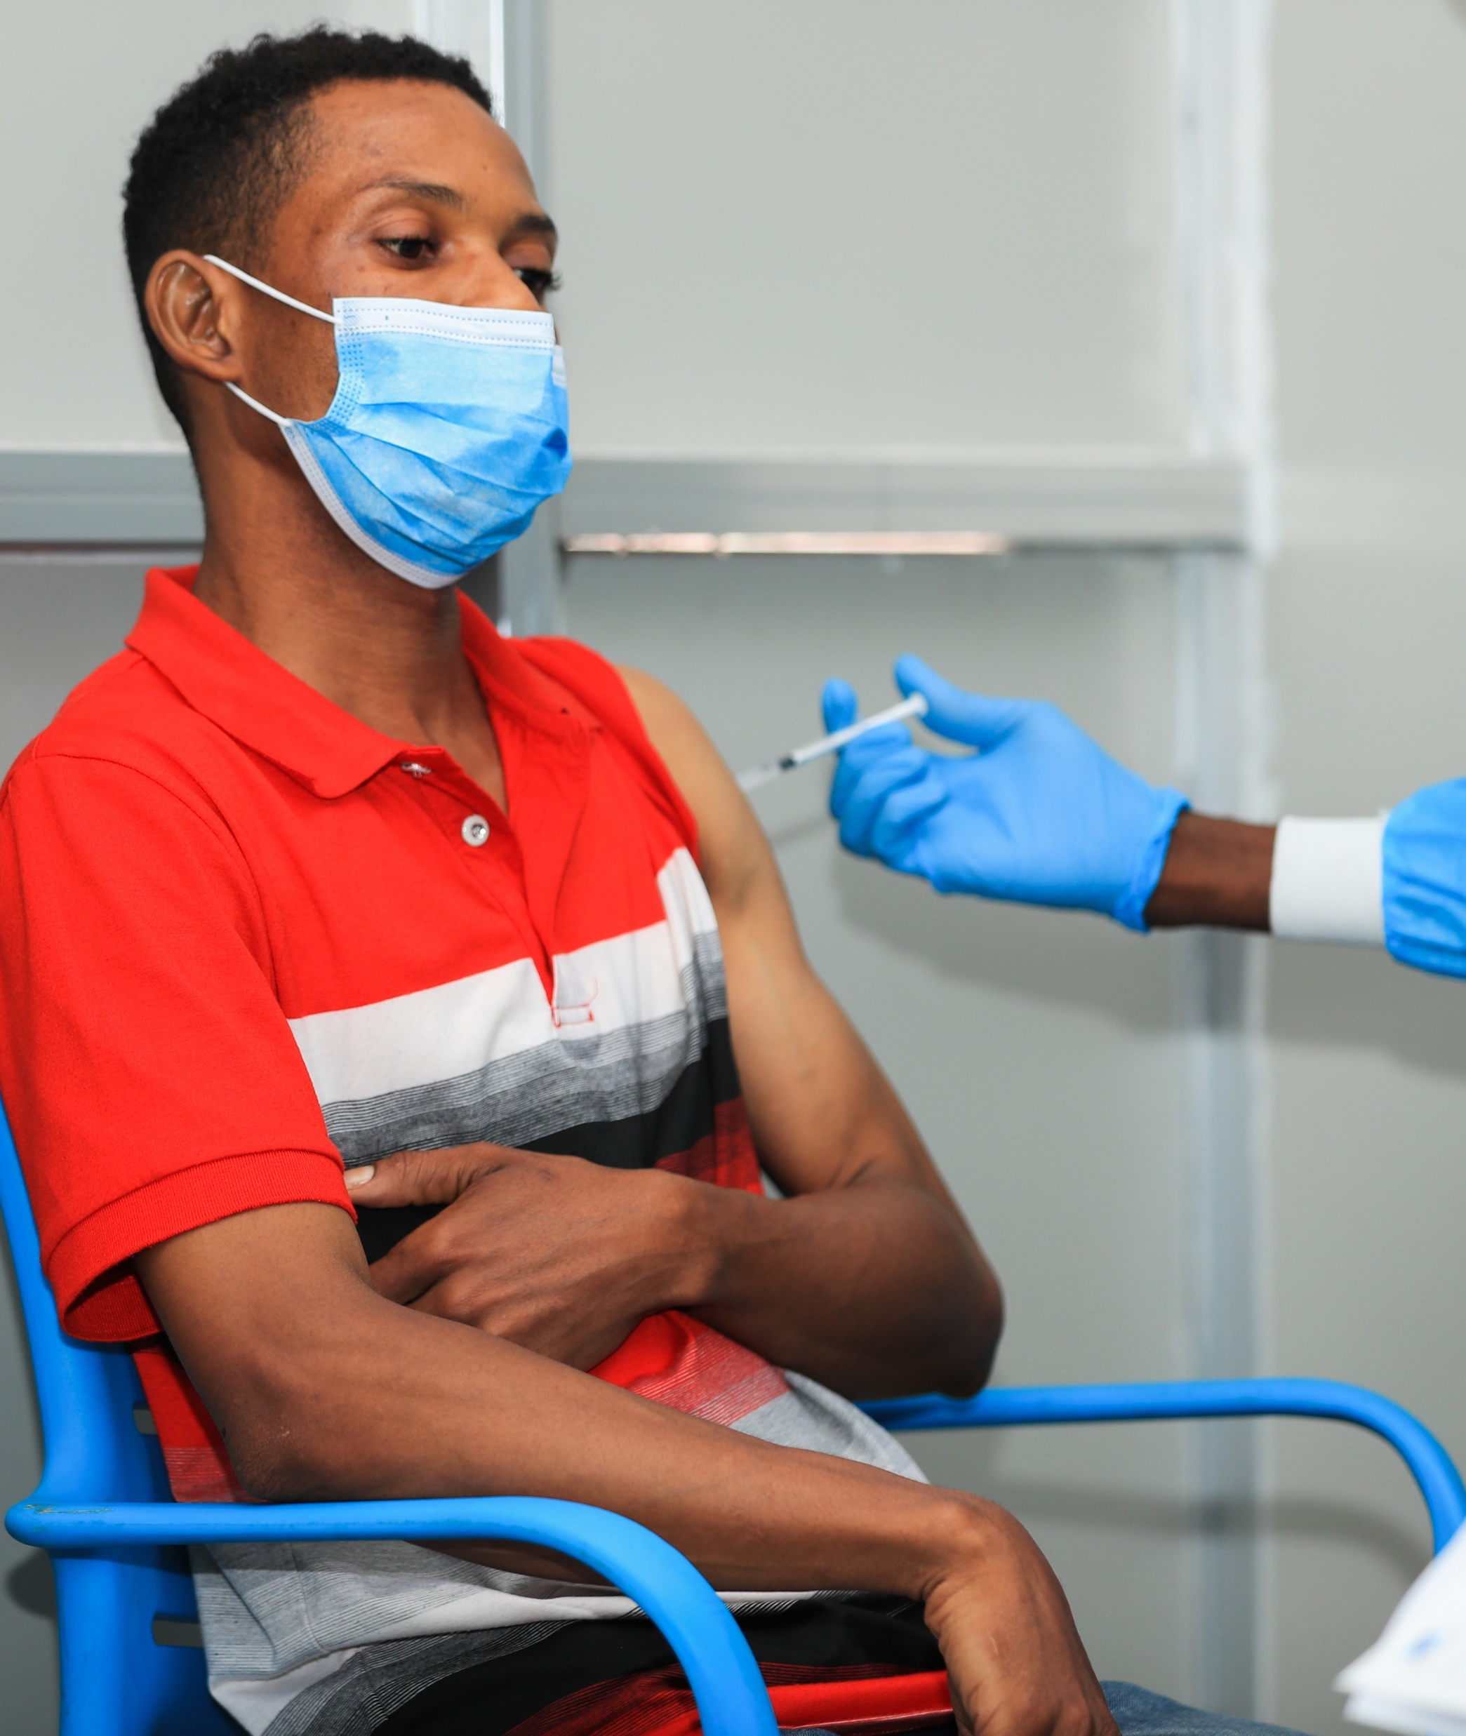
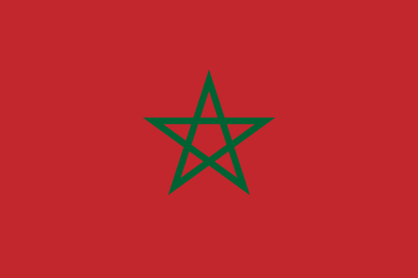
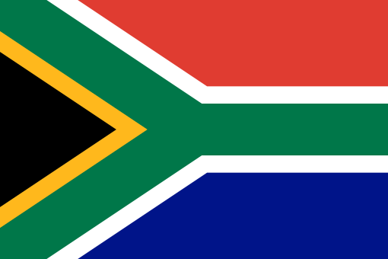
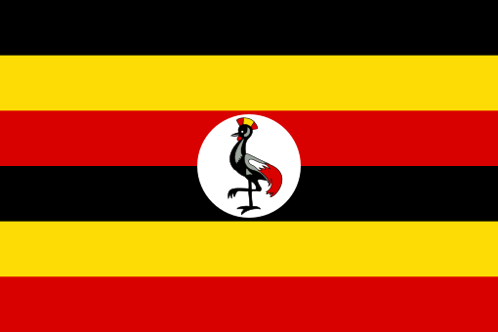
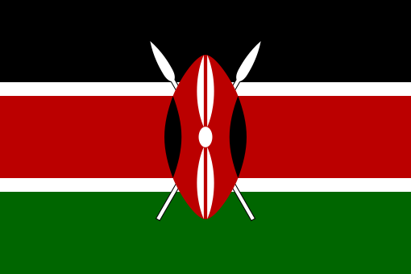
COVID-19 in Africa: Where are we today?
So far, seven African countries have already surpassed the target of vaccinating at least 70% of the population eligible for COVID-19 vaccination according to the WHO. Liberia and Rwanda have fully vaccinated their eligible populations, while Mauritius and Botswana have vaccinated 94 percent. Over 90% of the eligible population have also been vaccinated in Mozambique (92%), and in Seychelles (93%). Zambia has vaccinated 80% of the population eligible for the vaccine.
Meanwhile, approximately 49.9% of the continent's eligible population are fully vaccinated.
Over 12 million COVID-19 cases have been reported on the African continent since the outbreak began. Egypt, Ethiopia, Libya, Morocco, South Africa, and Tunisia have the highest number of reported cases.
Top 10 countries in Africa where vaccines have been administered
01
Nigeria
49% of eligible population
69 million
02
Egypt
51% of eligible population
41 million
03
Ethiopia
57% of eligible population
38 million
04
Tanzania
76% of eligible population
32 million
05
Morocco
80% of eligible population
23 million
06
South Africa
42% of eligible population
20 million
07
Mozambique
77% of eligible population
15 million
08
Uganda
47% of eligible population
13 million
09
Côte d’Ivoire
65% of eligible population
12 million
10
Kenya
33% of eligible population
11 million
Source: Africa CDC (2023)

Slide 3
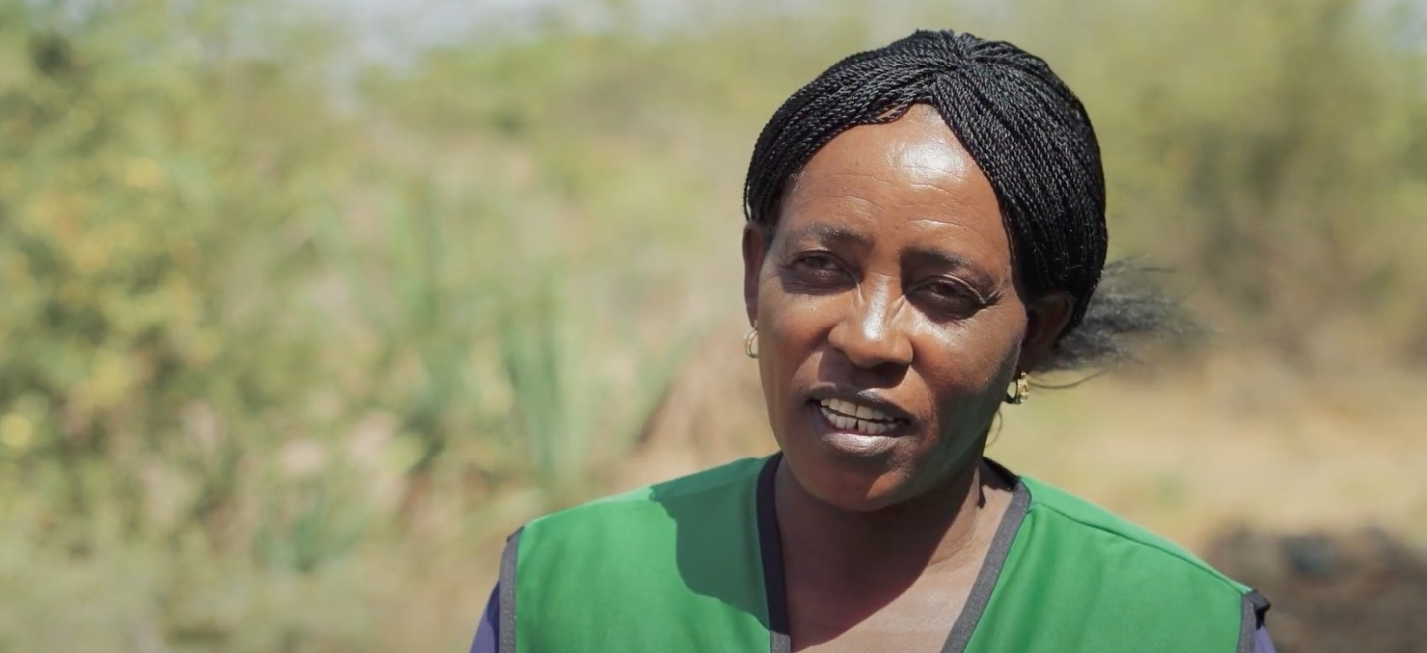
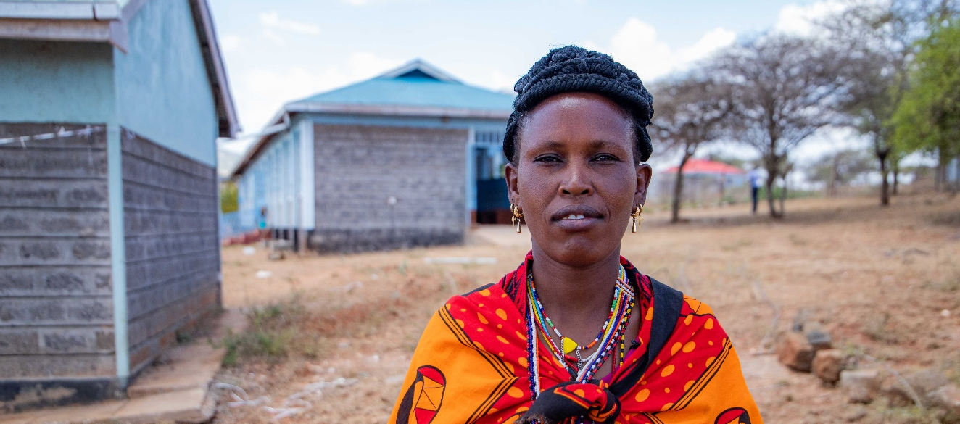
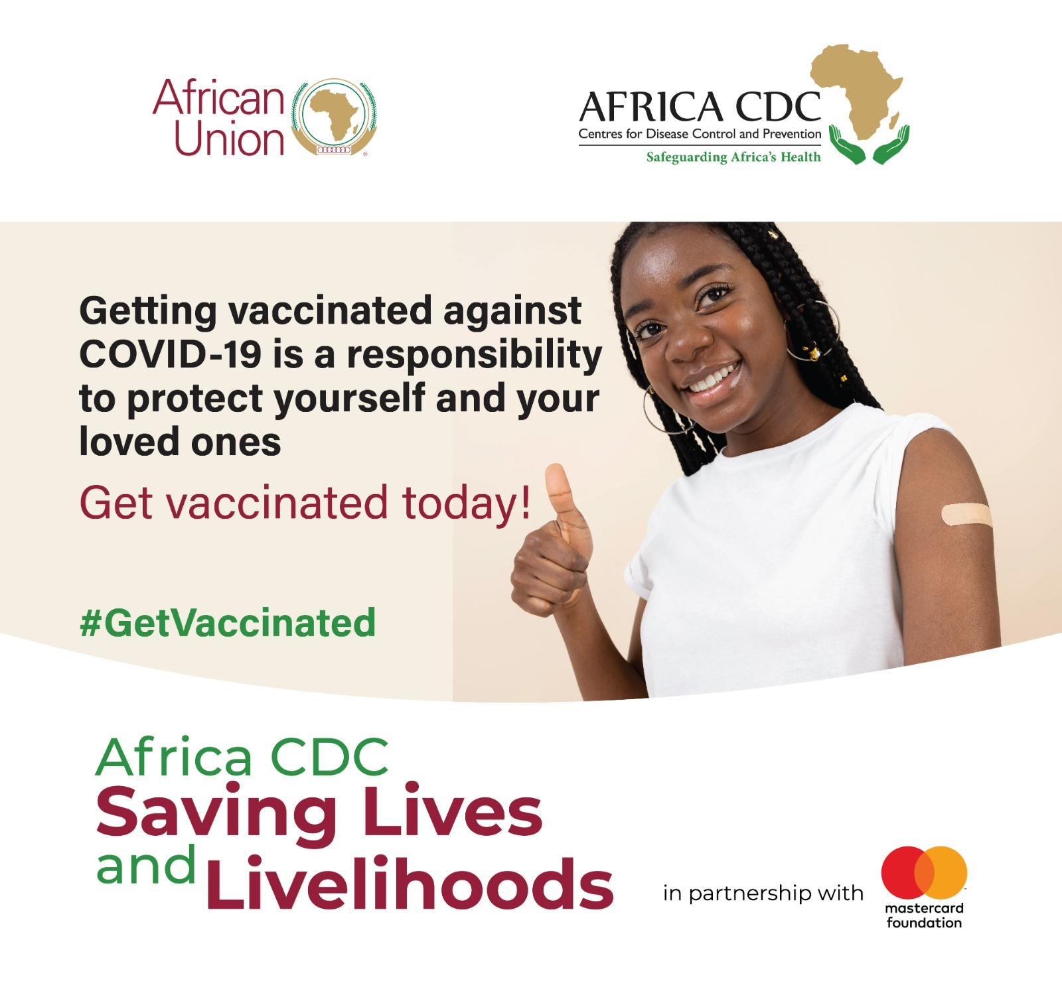
Updates on the Saving Lives and Livelihoods Initiative
African health champions: A celebration of grassroots women
Grassroots women across Africa are emerging as champions of healthcare, and we are thrilled to celebrate their contributions in honour of Women's History Month and International Women's Day. These incredible women are devoted to improving the health and well-being of their communities.
As part of the Saving Lives and Livelihoods initiative, we are committed to supporting and amplifying the work of these health champions.
‘’In efforts to promote COVID-19 vaccination, we go door to door to inform and educate locals about its availability and benefits. We are grateful for our partners' support and call for more to continue our work in the villages.’’
Agnes Kiilu, Community Health Volunteer from Kitui County in Kenya
“Despite experiencing temporary side effects, I feel more confident, energetic, and protected after receiving the COVID-19 vaccine. I urge all eligible individuals to get vaccinated for the benefit of our community's health.”
Betty Nguyo from Kumpa village in Kajiado County, Kenya
Saving Lives and Livelihoods Safety Message
Getting vaccinated against #COVID19 is easy and takes a few minutes. Don’t wait until the last minute. Protect yourself from serious illness, hospitalization, and even death.
#GetVaccinated

Slide 4
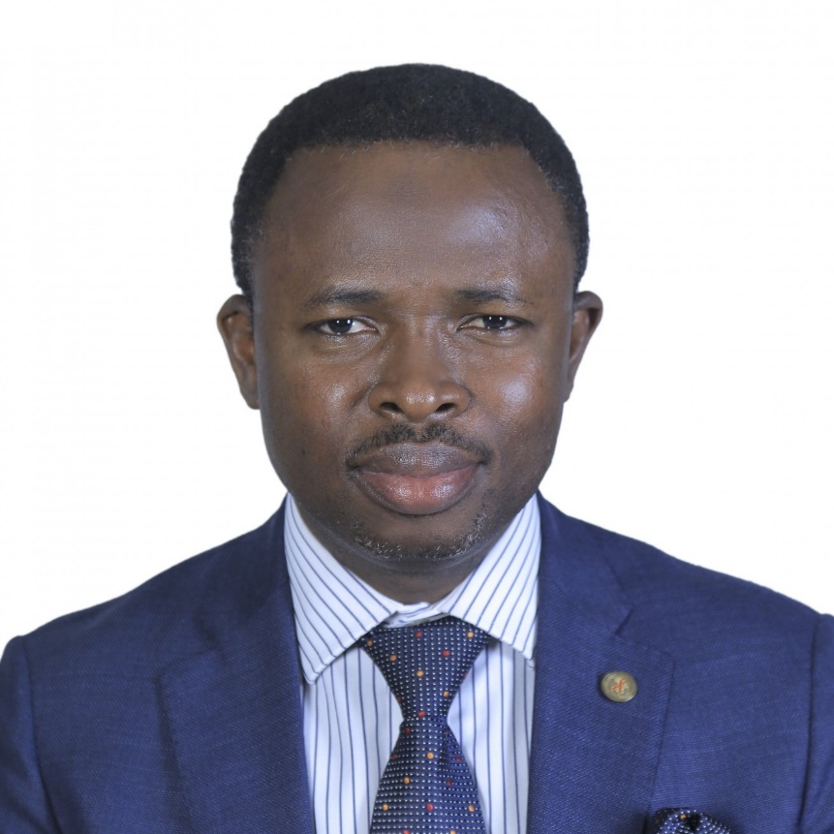
Strengthening health systems and partnerships across the continent
One-on-one with Dr. Raji Tajudeen, Head of Public Health Institutes and Research at the Africa CDC
Q: How has the Saving Lives and Livelihoods initiative helped to strengthen the Africa CDC to deal with future health crises and public health improvement across the continent?
The Saving Lives and Livelihoods intiative has four pillars, namely: procurement of vaccines, support for vaccine delivery to Member States, the groundwork for vaccine manufacturing through a focus on human capital development, and strengthening the capacity of Africa CDC. In terms of capacity building, we have onboarded 80 new staff and are on course to onboard a total of 106. These new staff are distributed across all existing Africa CDC Divisions and the Regional Coordinating Centers. The initiative offers many opportunities to strengthen Africa CDC, even as our mandate becomes more expanded.
Q: Briefly explain how the integration of COVID-19 vaccines is taking place among key implementing partners, including AMREF and the Red Cross Society.
When we set out to implement this programme, it was unanimously agreed that we will work as much as possible with our local Africa based implementing partners to strengthen their capacity. Local partners bring local context and allow for community ownership. As it is well known, every pandemic begins and ends at the community level. The programme has strengthened the capacity of local implementing partners as well as the health systems of our Member States. For instance, we provided a grant to Amref Health Africa to implement COVID-19 Vaccination Centres (CVCs) in East and Southern Africa.
Dr. Raji Tajudeen is responsible for coordinating the establishment and strengthening of national public health institutes across the 55 African Union Member States; coordinating the Africa CDC Health Workforce Development portfolio and the broader public health research agenda.
He also heads the healthcare preparedness and countermeasures section of the Africa CDC COVID-19 Response and co-chairs the Case Management Technical Working Group of the Africa Taskforce on COVID-19. Dr. Raji coordinates the Programme Management Unit of the Saving Lives and Livelihoods initiative, supporting vaccine delivery to millions across the continent.
He discusses how to safeguard Africa’s health in light of the COVID-19 pandemic.
Continues

Slide 5
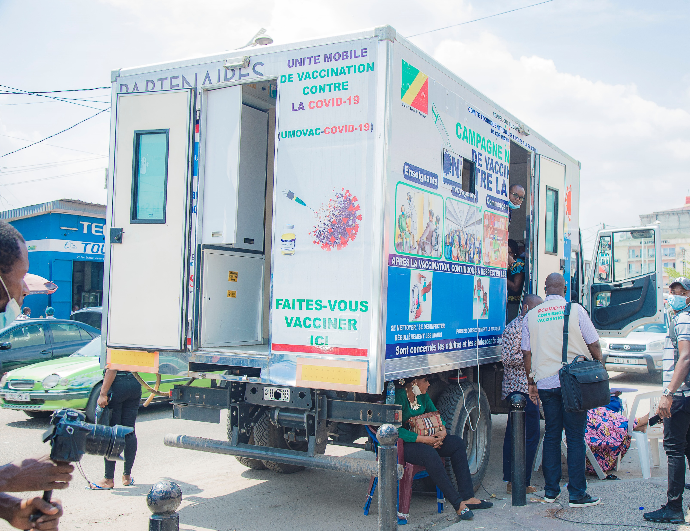
Strengthening health systems and partnerships across the continent
In the medium to long term, Africa needs to find a way to build its own local manufacturing capacity for vaccines, diagnostics, therapeutics, and even oxygen. The Partnerships for African Vaccine Manufacturing (PAVM) was established by the African Union (AU) in 2021 to enable the African vaccine manufacturing industry to develop, produce, and supply over 60 percent of the total vaccine doses required on the continent by 2040.
Going forward, it is crucial to establish a strong and equitable global medical supply chain that can provide reliable information on the availability of medical supplies. This will allow us to plan and prepare for the delivery of vaccines and other health-related products. In so doing, we will increase the resilience of our health systems and ensure that we are prepared for future health crises.
Q: Lastly, as we talk about health security, we cannot ignore the ongoing challenges such as drought in the Horn of Africa. Are there ways that the Africa CDC can help mitigate some of these challenges that impact the community while seeking to address health insecurity?
The COVID-19 pandemic has highlighted the importance of viewing health as a security, socioeconomic, and developmental issue. As we developed the Saving Lives and Livelihoods initiative, we recognized the need to strengthen systems and establish a flexible, integrated, and resilient healthcare infrastructure. Currently, Somalia, Ethiopia, and certain regions of Kenya are experiencing drought, which has significant health implications. The initiative is actively seeking ways to provide support in this area, including risk communication and community engagement to address the health and nutritional needs of affected populations.
This strengthened the primary healthcare systems of these Member States and more importantly, the relationship between Africa CDC and the implementing partners. This is in line with the New Public Health Order that in part emphasizes the need for respectful and action-oriented partnerships.
Q: Looking at the first pillar of the initiative which focuses on vaccination, what measures exist to ensure a sustainable supply of vaccines in the continent?
In the context of the ongoing COVID-19 pandemic, we reached out to the global platform, COVAX and relevant partners including Governments from the global North to ensure we get COVID-19 vaccine supplies as soon as possible to close the vaccination gaps. The Saving Lives and Livelihoods initiative is procuring vaccines for 65 million people and facilitating the delivery of COVID-19 vaccines in our Member States irrespective of the source of the vaccine. Support for vaccine logistics to ensure equitable distribution of COVID-19 vaccine and other vaccines is a key component of the Saving Lives and Livelihoods programme.

Slide 6
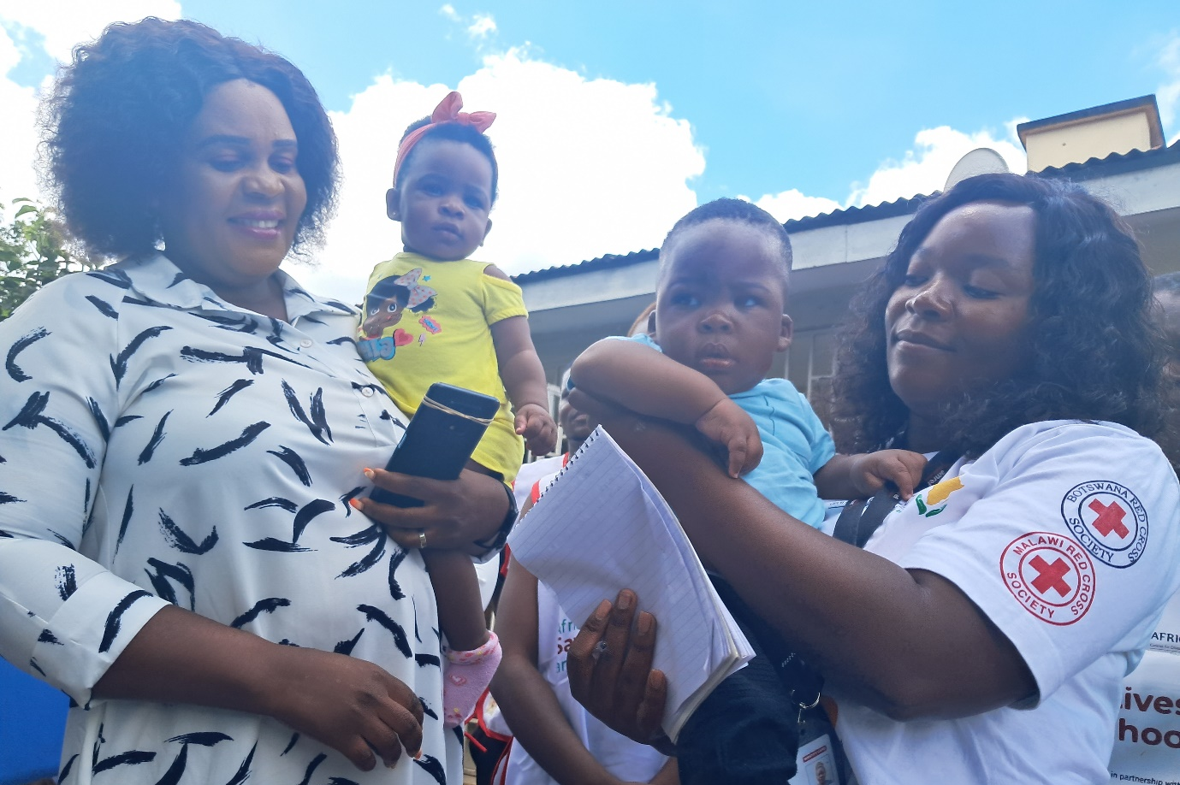
Spotlight on Risk Communication and Community Engagement (RCCE)
Snapshot of key successes for COVID-19 vaccination acceleration in Africa
Christina Kamodzi (right) with the Amref Coordinator for Blantyre District
Malawian woman overcomes misconceptions, gets vaccinated while pregnant, and delivers healthy twins
Christina Kamodzi, a 41-year-old woman from Zingwangwa in Blantyre, Malawi, has received recognition for her decision to get vaccinated against COVID-19 despite rumours and misconceptions about the vaccine's impact on pregnant women.
Christina received her first and second doses of the Pfizer vaccine while pregnant with her twins, a healthy baby boy and a girl who are now nine months old. She has also received a booster shot since then. Her decision to get vaccinated and deliver healthy twins is an inspiration for women everywhere during Women’s Month in March.

Slide 7
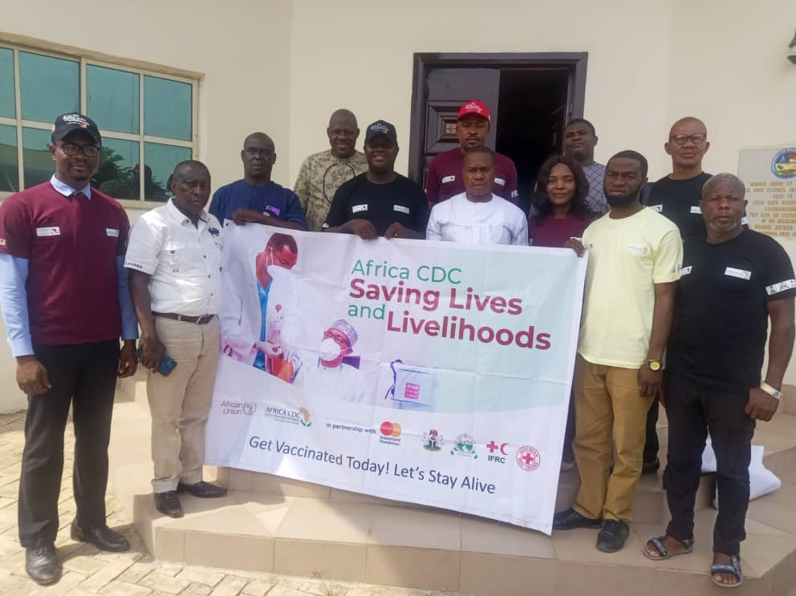
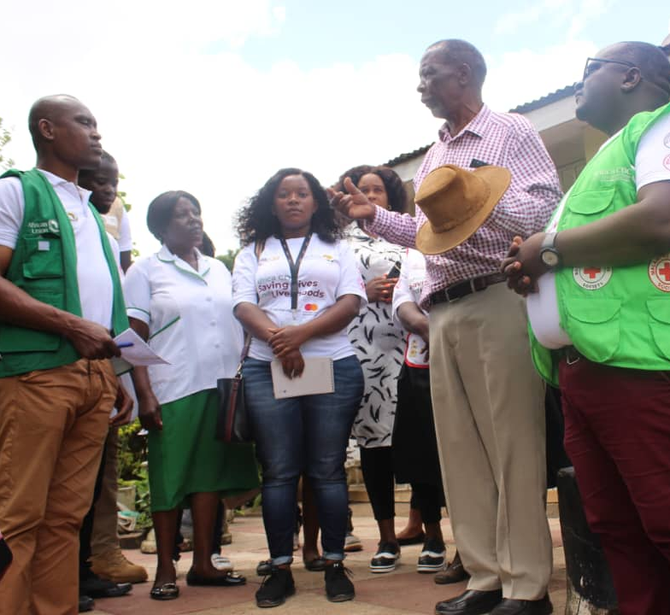
Spotlight on Risk Communication and Community Engagement (RCCE)
Octogenarian leads the way in COVID-19 vaccination drive in Malawi
Stafford Pindani, an 84-year-old community leader, is leading by example when it comes to COVID-19 vaccination in Malawi. When the vaccination drive started, many people were hesitant to get vaccinated due to fear of the unknown. However, Stafford recognized the seriousness of the virus and encouraged his community and other leaders to get vaccinated. His adherence to COVID-19 messaging and vaccination has protected him from the virus, and it has also allowed him to travel and be with family in other countries. Stafford's leadership and advocacy for vaccination is an inspiration to others during the pandemic.
Stakeholders from Nigerian Red Cross Society and Nigerian Union of Journalists in Delta State
Nigeria Red Cross partners with journalists to advocate for COVID-19 vaccination in Delta State
The Delta Branch of the Nigerian Red Cross Society (NRCS), in partnership with the Delta State Primary Health Care Development Agency, recently paid a visit to the Nigerian Union of Journalists (NUJ) in Delta State as part of the NRCS's humanitarian mandate to sensitize people about the importance of taking the COVID-19 vaccine to protect themselves from the viral disease.
The partnership highlights the importance of collaboration in the fight against COVID-19. By working together, these organizations can effectively reach out to more people and encourage them to get vaccinated, ultimately helping to curb the spread of the virus in Delta State.
Stafford Pindani (in checked shirt) a community leader in Zingwangwa, Blantyre in Malawi

Slide 8
^{Other Important Developments}
Africa CDC at the World Vaccine Congress
The Africa Centres for Disease Control and Prevention (Africa CDC) will be exhibiting at the 2023 World Vaccine Congress- from 3-6 April 2023 at Walter E Convention Center, Washington DC. The theme of the congress is Research and Development + Strategic Partnering for the Global Vaccine Industry. The Africa CDC and Mastercard Foundation are showcasing the Saving Lives and Livelihoods initiative, particularly focusing on regionalizing vaccine manufacturing in Africa with the Partnership for African Vaccine Manufacturing (PAVM).
Read more
Africa CDC partners with Texas A&M University to offer vaccine manufacturing training
Africa CDC in collaboration with Texas A&M University National Centre for Therapeutics Manufacturing (NCTM) is organizing short-term course training relevant to biopharmaceutical manufacturing. The training is part of the Partnerships for African Vaccine Manufacturing (PAVM), which aims to enable the African vaccine manufacturing industry to develop, produce, and supply over 60% of the total vaccine doses required on the continent by 2040. Applications close on March 31, 2023, and selected candidates will be notified by April 7, 2023.
For more details and to apply, click here.
Africa CDC Launches Strategic Plan to advance public health in Africa
The Africa CDC has published its second strategic plan for 2022-2026, designed to champion the implementation of Africa's New Public Health Order and advance public health in Africa. The strategic plan is informed by the assessment of the first strategic plan (2017-2021) as well as lessons from numerous health emergencies, including the COVID-19 pandemic, and takes into account the evolving socio-economic character, demographic, and cultural realities of the continent.
Read more
PAVM sets objectives and deliverables for 2023 at Kigali meeting
The Africa CDC hosted a meeting in Kigali, Rwanda, from March 5 to 8, 2023 to discuss objectives and deliverables for the Partnership for African Vaccine Manufacturing (PAVM) in 2023. PAVM was established by the AU in 2021 to enable the African vaccine manufacturing industry to produce and supply over 60% of the total vaccine doses required on the continent by 2040.
The lead partners reviewed PAVM's eight bold programs outlined in the PAVM Framework for Action, prioritized a set of practical actions, and defined a collaboration framework that enables implementation effectiveness and quick results in support of African vaccine manufacturing.
Read more

Slide 9
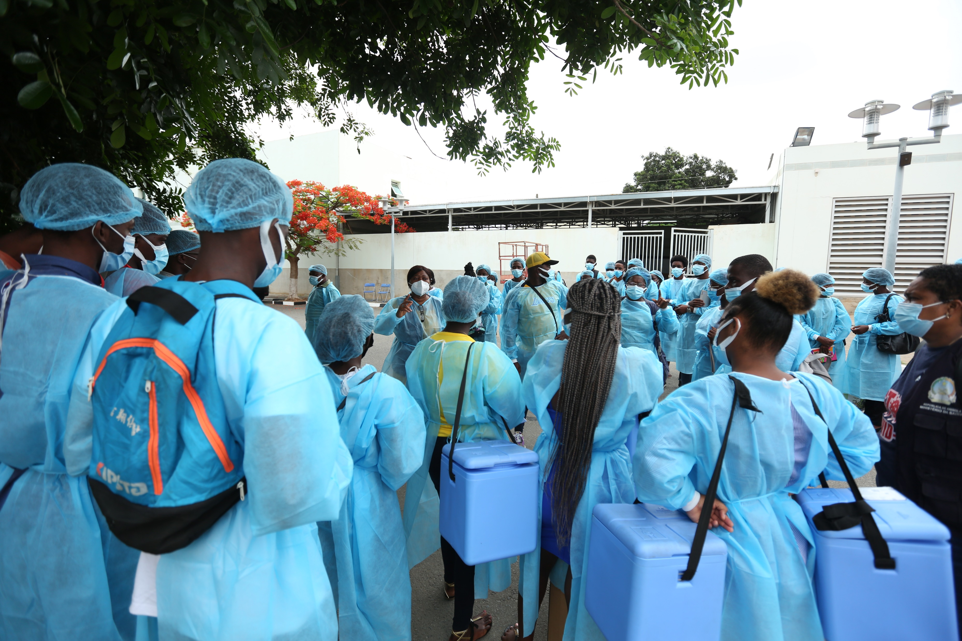
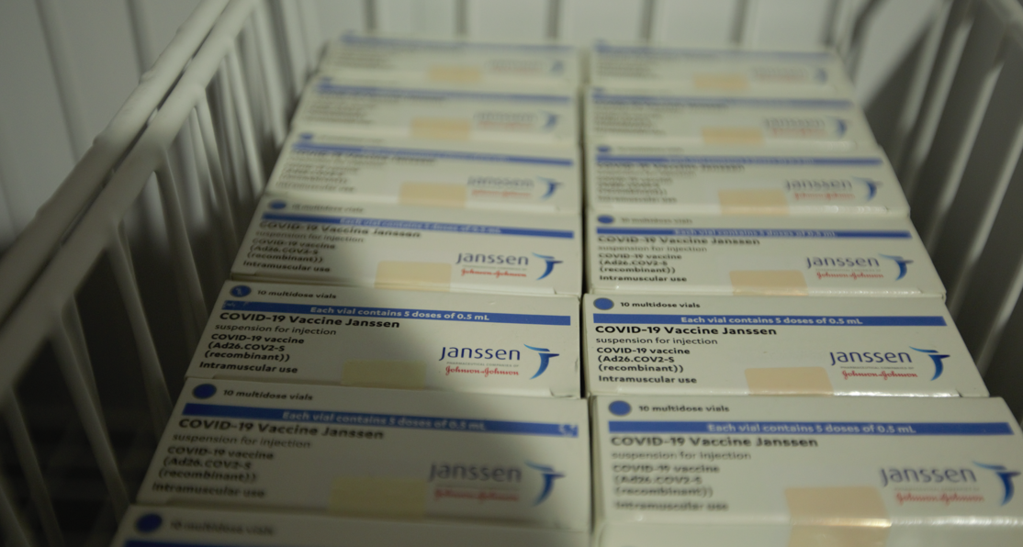
^{News & Media}
World figures call for an end to vaccine inequality three years into COVID pandemic
Nearly 200 prominent world figures signed an open letter coordinated by the NGO coalition People's Vaccine Alliance, calling for an end to vaccine inequity during the COVID-19 crisis. The letter was published to mark the three-year anniversary since the WHO declared COVID-19 a pandemic. Read more
COVID-19 hasn’t lost its punch, experts warn
Health experts around the word are warning that COVID-19 is still a threat with more variants sweeping the planet amidst information sources drying up and getting harder to track the pandemic. Read more
Study analyses health benefits and cost-effectiveness of COVID-19 vaccination programmes in Africa
A new study published in BMC Medicine has analysed the impact of COVID-19 vaccination timing and speed on virus transmission in 27 African countries, based on a combined epidemiological and economic modelling approach. The study highlights the importance of vaccine efficacy and lower vaccine purchasing costs in improving the overall affordability and cost-effectiveness of COVID-19 vaccination programs in African countries. Read more
Moderna seals deal to build mRNA facility in Kenya
Moderna and the Kenyan Government announced on Thursday, March 30th, a deal to construct a $500 million mRNA vaccine manufacturing facility in Nairobi. The facility is expected to produce up to 500 million vaccine doses per year for COVID-19 and other conditions, potentially leading to advancements in treating other respiratory diseases and neglected tropical diseases. Initially, the facility will focus on vaccine manufacturing with plans to expand its capabilities to include the filling of vaccine vials and packaging at the site. Read more

Slide 10
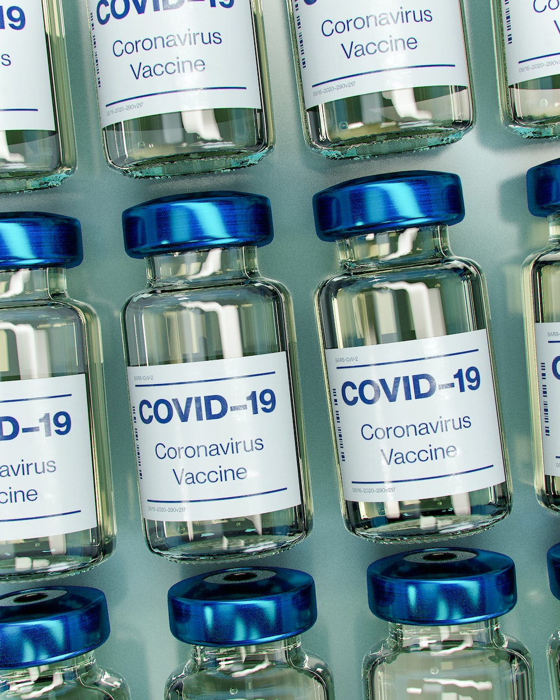
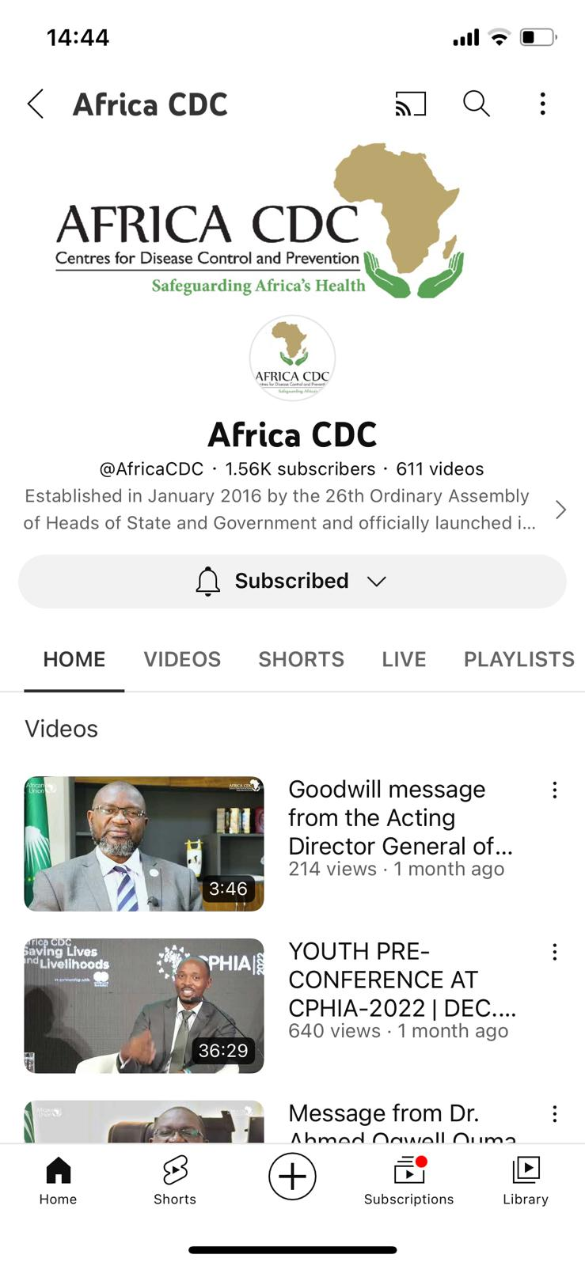
^{News & Media}
African countries to establish local vaccine manufacturing plants to fight future pandemics
Experts and leaders in Africa have resolved to establish a local vaccine manufacturing plant to fight future pandemics. Africa CDC has plans of establishing diagnostic laboratories and therapeutic services to prepare Africa for future pandemics The WHO is also working towards improving regulatory capacities for six African countries, including Rwanda, Nigeria, Ethiopia, Ghana, Kenya, and Algeria, to manufacture vaccines. Read more
Stay informed and up to date on the latest developments in public health
Subscribe to the Africa CDC's official YouTube channel to access resources, updates, and expert insights on a range of public health issues in Africa. Stay informed on the latest research, guidelines, and best practices, and be better equipped to positively impact public health. Subscribe here.
Subscribe now

